Slide 1
PHP ECommerce
Shopping Cart Workflow

Slide 2
PHP ECommerce
Overview
This describes the web pages we will create for the Shopping Cart project.

Slide 3
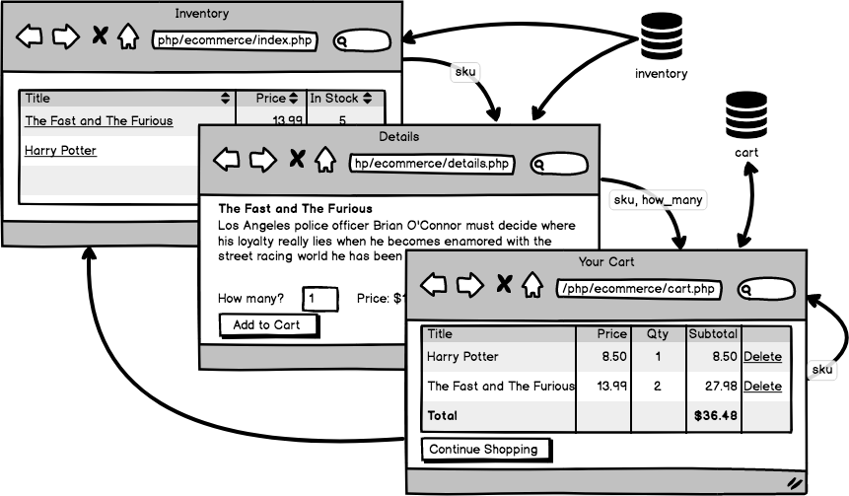
PHP ECommerce
index.php → details.php → cart.php → index.php . . .

